Slide 1
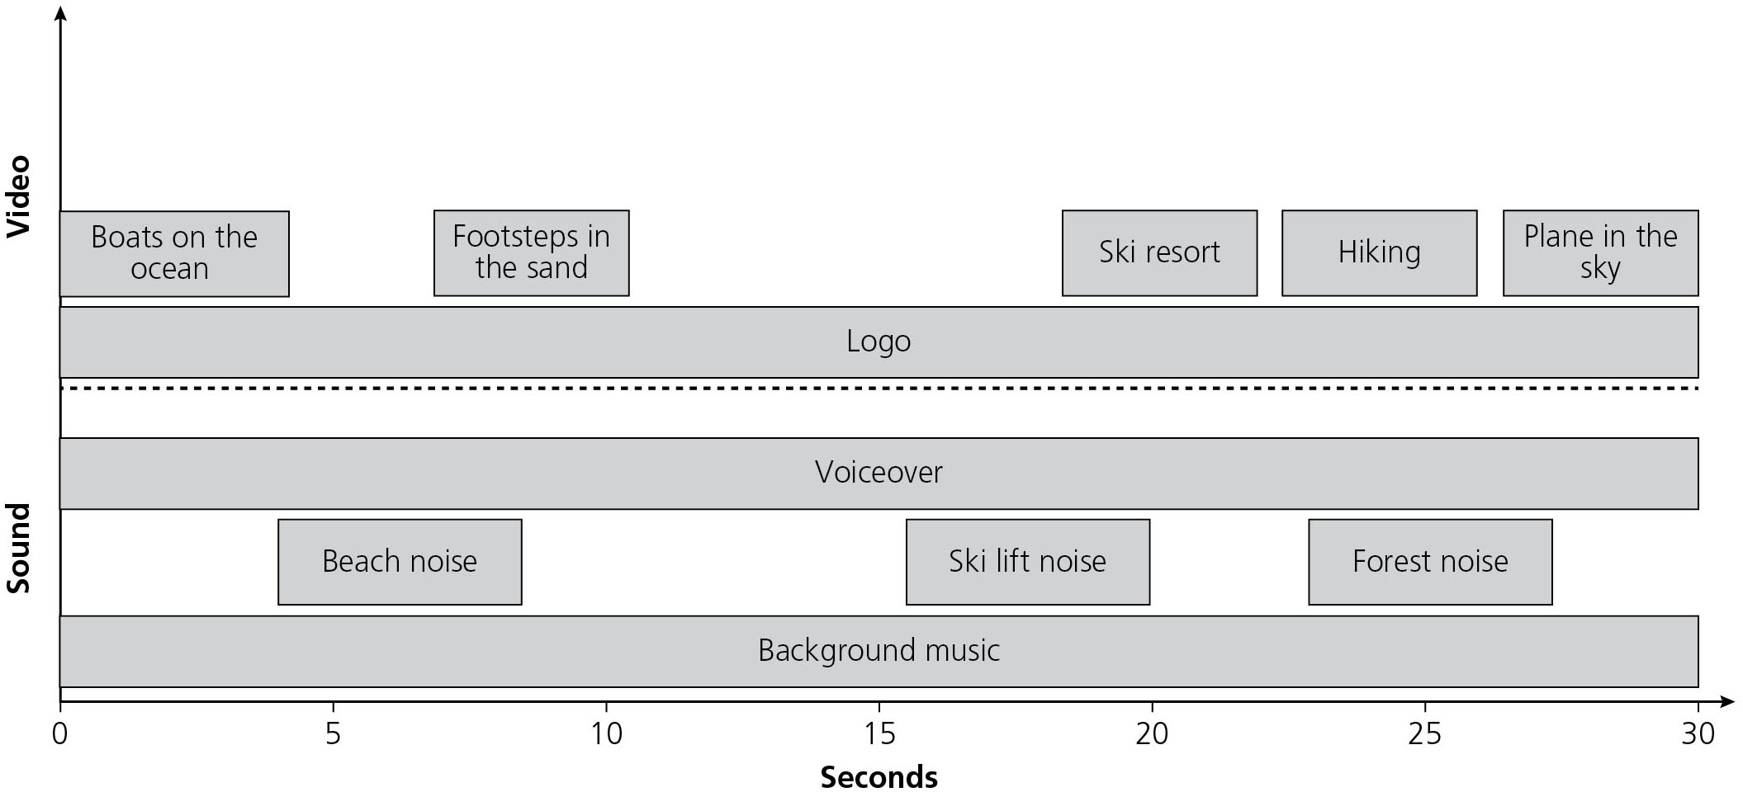
PowerPoint 4.1

